Slide 1


Understanding the sampling effort
on Covid-19 case numbers
Presenter: LBDB3
Discipline: Statistics (medical statistics)
Supervisor: Dr. Manolopoulou Ioanna
Notes:
Hello everyone, I'm Wang Hanlin, This is my final project Understanding the sampling effort on Covid-19 case numbers

Slide 2
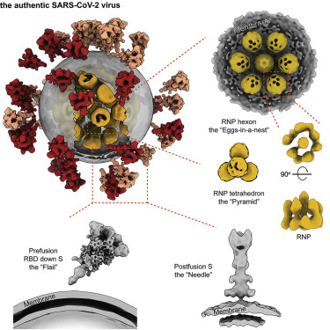

Covid-19
In the end of 2019,
the new coronavirus,
Severe Acute Respiratory Syndrome Coronavirus 2 (SARS-CoV-2),
outbroke in China and soon affect nearly all countries.
This is named after : COVID-19.
Figure1: Molecular Architecture of the SARS-CoV-2 Virus (Yao et al. 2020)
Notes:
In the end of 2019, the new coronavirus, severe acute respiratory syndrome coronavirus 2 (SARS-CoV-2), outbroke in China and soon nearly all countries suffer from this new diseases.
This coronavirus disease is named after : COVID-19.

Slide 3
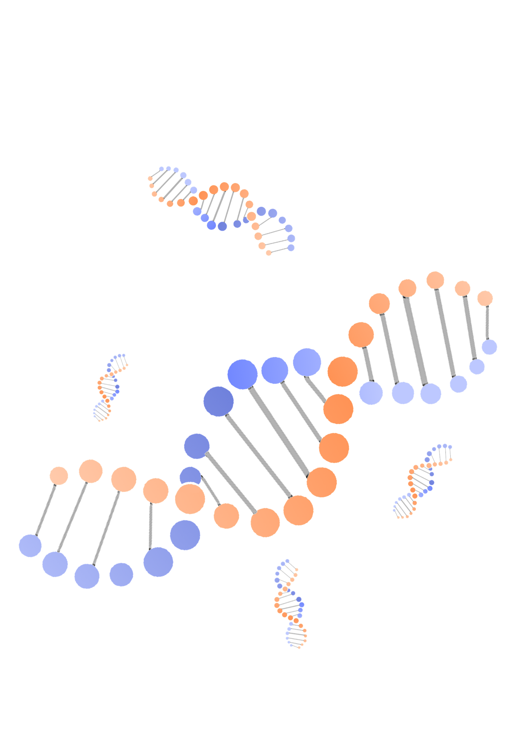

01
Introduction
02
Methodology
Outline
03
Result analysis
04
Conclusion
Notes:
My presentation would be divided into this 4 parts
Since the presentation is short, I’m not sure you need an outline slide. However, it’s sometimes helpful to have one so that you can focus and be less nervous for the presentation. This is not really crucial since you will record your presentation, but it’s a useful tip when talking to a crowd: make 1-2 easy slides to help you calm your nerves.

Slide 4
Thesis statement
Daily increasing cases reported by the UK government are always underestimated.
The effectiveness of testing is constantly improving with fluctuatations and reached 23.77% (8.81%, 66.64%) before the 1st October 2020.
Notes:
The overall finding of my thesis this that: the daily increasing cases reported by the UK government are always underestimated and the effectiveness of testing is constantly improving with some ups and downs before the 1st October 2020, when is the last day of the study span of this thesis.

Slide 5
Introduction
Notes:
First is the introduction part

Slide 6
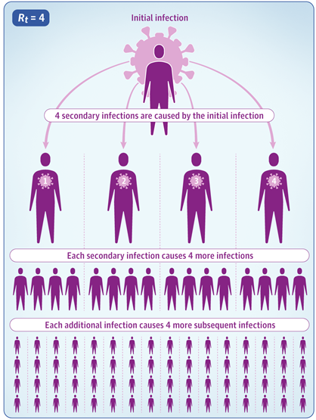
Basic Reproduction Number (R_{t} )
R_{t}: the average number of infections produced by each infected case. (Flaxmanet al., 2020)
The direction of change
R_{t}
The speed of change
Figure2: The diagrammatic sketch of the R_{t} (Thomas, 2020)
Notes:
R_{t} is a basic epidemiological number, which represents the average number of infections produced by each infected case during the infection.
If Rt is 0.5 then, on average, for each 2 infected person there will be only 1 new infection. The Rt indicates the direction of change, with a value greater than 1 meaning the epidemic is growing and a value less than 1 meaning the epidemic is shrinking. However, the Rt alone does not indicate how quickly an epidemic is changing because it does not consider the time taken for each transmission to take place.
By the way, the serial interval can assess the transmission speed of the epidemics.

Slide 7
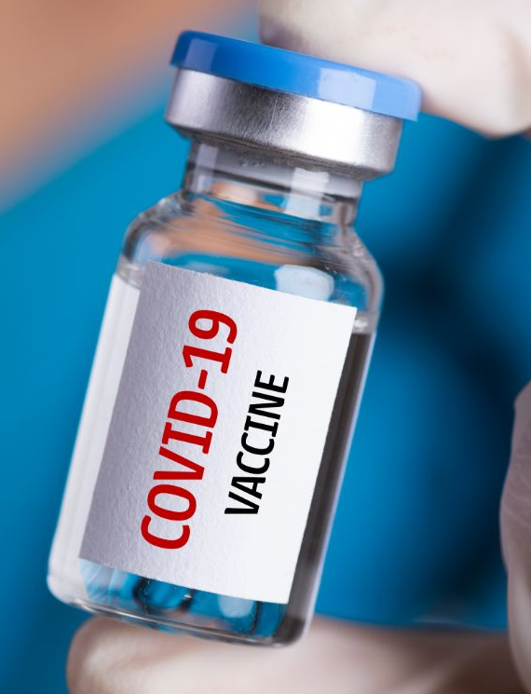
Non-Pharmaceutical Intervention (NPI)
NPI was the only effective method to contain the Covid-19 at the early stage of Covid-19.
Even if vaccine has been injected, NPI would still be the main method.
Many people protest for the NPI policies because of the freedom.
Notes:
Non-Pharmaceutical Interventions (NPI) were the only effective method to contain the Covid-19 at the early stage of Covid-19. Even if vaccine has been injected, there tend still to be the main methods.
The NPI policy response to COVID-19 can be complex. These policies can be at a country level or a local. NPI usually contains closings of schools and universities, closings of workplaces, stay at home requirements and restrictions on internal movement between cities/regions. As the epidemic upwards, the restriction of these NPI policies would be eased.
However, there are many people in the UK protest for the NPI policies because of the freedom. Particularly in June, because the search index of the protest in google peaked at that time

Slide 8
Thesis time span
31st Jan.
2020
The first two COVID-19 cases in the UK were confirmed
The start of the epdemic in the UK
Time span
1st Oct.
2020
The first mutation (Alpha) was found in the UK
The variant of the nature of SARS-CoV-2
Notes:
Based on the things introduced in the previous slide, the time span of the study could be determined. For the start, the first two covid-19 cases in the UK were confirmed on January 31st, and for the end, the cornavirus tended to mutate in October 2020, the nature of the mixture of coronavirus are hard to be modeled. Meanwhile, the first injection of vaccine is in 8th December 2020. Hence the time span of my study is from 31st January to 1st October 2020.

Slide 9
Data description
All data for this thesis
Solid: Observed cases
in the ventilation beds,
deaths, in hospital
Dotted: NPI
lockdown (for city), lockdown of schools and universities, and the protest index.
Figure 4:All data used from 31st Jan to 1st Oct 2020
Notes:
There are lots of lock-down and reopen policies for UK. An straightforward way to describe these policies is to use dummy variables. However, if all policies are add to the model as dummy variables, this model cannot fit well. Due to the multicollinearity problem, the variance of the coefficient of each NPI policy on Rt will be very large in this model fitting, which leads to the unreliability of the final result.
Therefore, I combined all policy variables to a single continuous variable, describing the NPI policies by using manually subjective scoring. By this, the meaning of the NPI policy is retained to the greatest extent. Meanwhile, the disadvantages of this method are rather obvious. Since the scores are measured manually, this variable can be very subjective. Therefore, in the following inference, it is necessary to verify whether this scoring principle complies with data in practice.
Particularly, the variable Lockdown means the lockdown for cities, while the schools and universities means the lock-down for them.

Slide 10

Methodology
Notes:
Second is the Methodology part

Slide 11
Basic method
Markov chain Monte Carlo
Calculate large-scale hierarchical models
Bayesian Linear Regression
Renew the posterior probability distribution
Notes:
The main methods used in this thesis are Markov chain Monte Carlo simulation and Bayesian linear regression, as the result of these methods, the simulation result would be presented as a distribution and has high correlation with the prior and parameter distributions.

Slide 12
Model Assumptions
1
During the time span, the mutation of the cornavirus did not occur
2
The nature of the cornavirus will change only if it mutates
3
The antibodies in the cured patients do not affect further infections.
Notes:
For the first assumption. we have known that the first mutation alpha strain was found on October, but no one konws when the cornavirus mutated, therefore, this assumption should be held.
Because the MCMC and Beyasian regression has used. I assume all distributions used in this thesis are invariate. The nature of the cornavirus has many aspects such as serial interval, which means the time distribution of the transmission from patient to patient. and mortality rate, hospitalization rate,
At the end of my thesis time span, nearly 6% people in the UK has antibody, this rate is not so large. It is known that a person can be infected twice with the Covid-19, but the probability of a second infection will be much less than the first time because of the appearance of antibodies in his/her body. However, in the time span of our research, the concentration of antibodies in the population was not high, so we ignored the adverse effects of antibodies in the time of the research

Slide 13
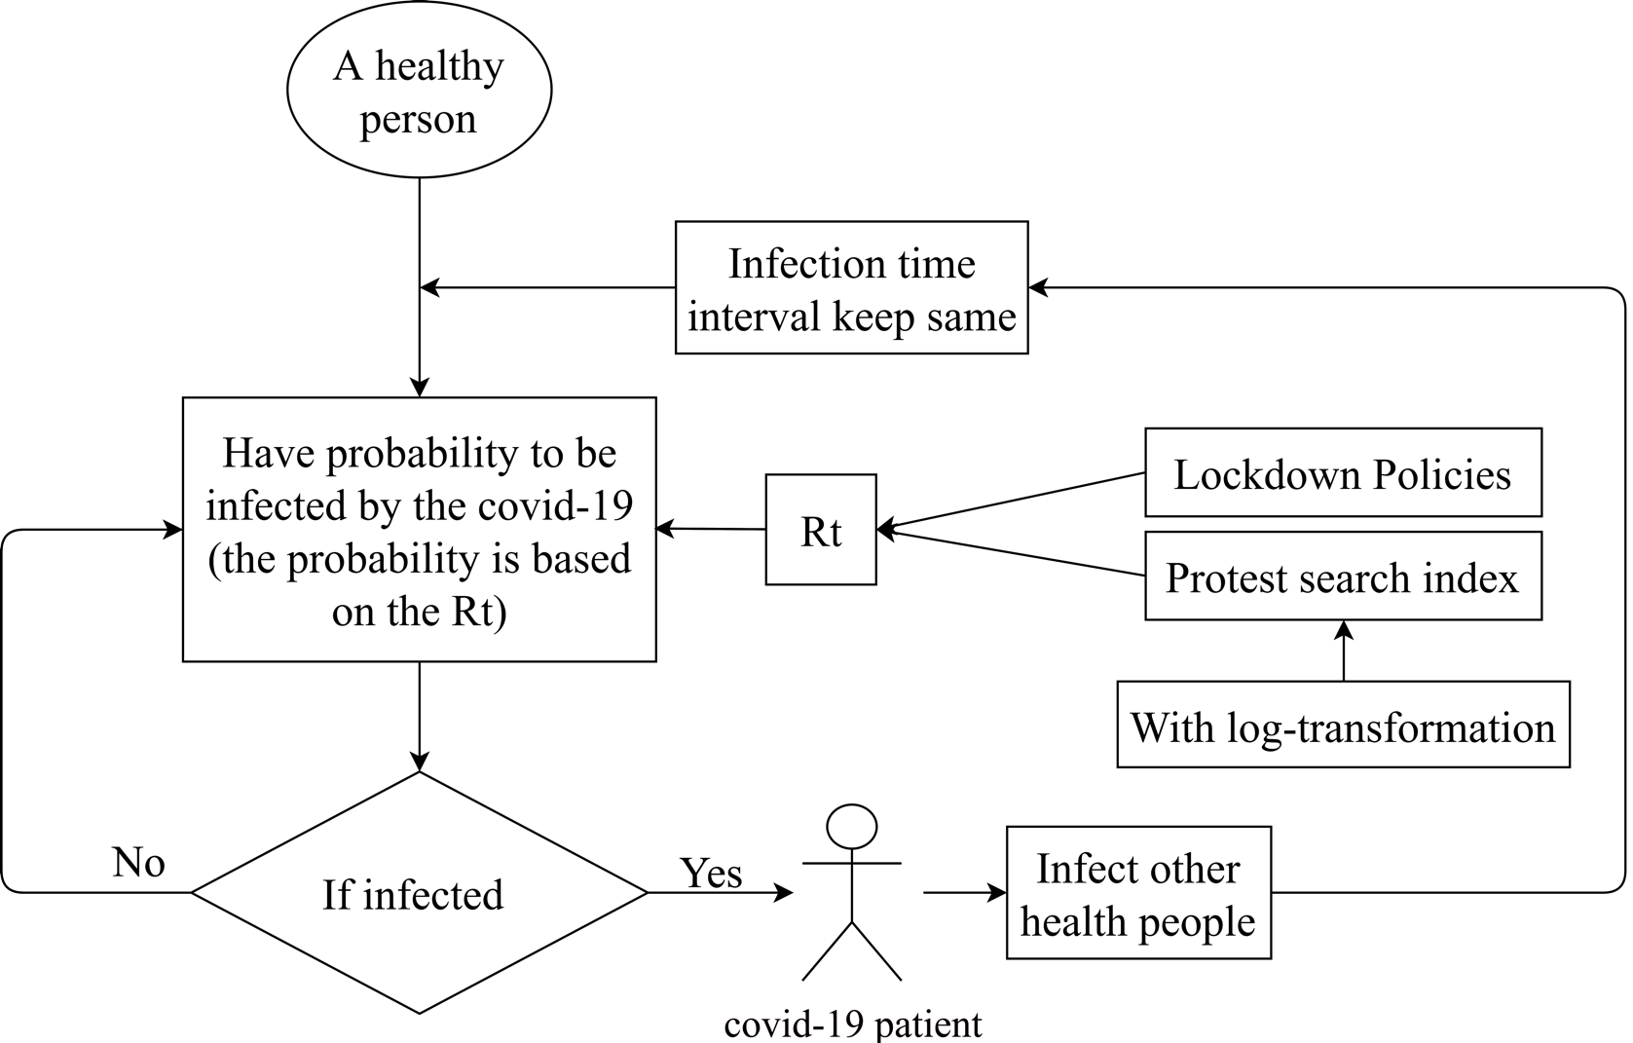
Ways to inferring the sampling effect
Figure 5: The inference process of the sampling effect
Notes:
In the beginning, the probability of a healthy person to be infected is determined by the Rt, and the time when the person is infected is affected the series interval. Besides, the calculation of the Rt is based on the state of NPI and search indexes of “protest” on google. Meanwhile, when the infection time interval keeps the same in a single day sampling from the distribution, it is worthy highlighting that the number of infected individuals will also boost the transmission.

Slide 14
Ways to inferring the sampling effect
The probability from infection to being in the ventilation beds follows a certain constant distribution
The gap between patients in beds and theoretical number would be affected by the patients in hospital
In the
bed or
not
Yes
Become a in bed case
The gap between fatality data and theoretical number would be affected by the patients in hospital
The probability from infection to fatality follows a certain constant distribution
Death
or
not
Become a fatality case
Assuming the fatality data is equal to theoretical number overtime
Figure 5: The inference process of the sampling effect
Notes:
After being infected, I use three method to model it. Assuming the rate that patient admitted to the mechanical ventilation beds and fatality are conform constant distributions. when these data are observed, the daily cased could be inferred
Furthermore, the observed number of fatality or admitted to mechanical ventilation beds maybe not equal to theoretical number, the shortage of medical source causes this gap. This model would consider this situation

Slide 15
Result Analysis
Notes:
Third is the Result analysis part

Slide 16
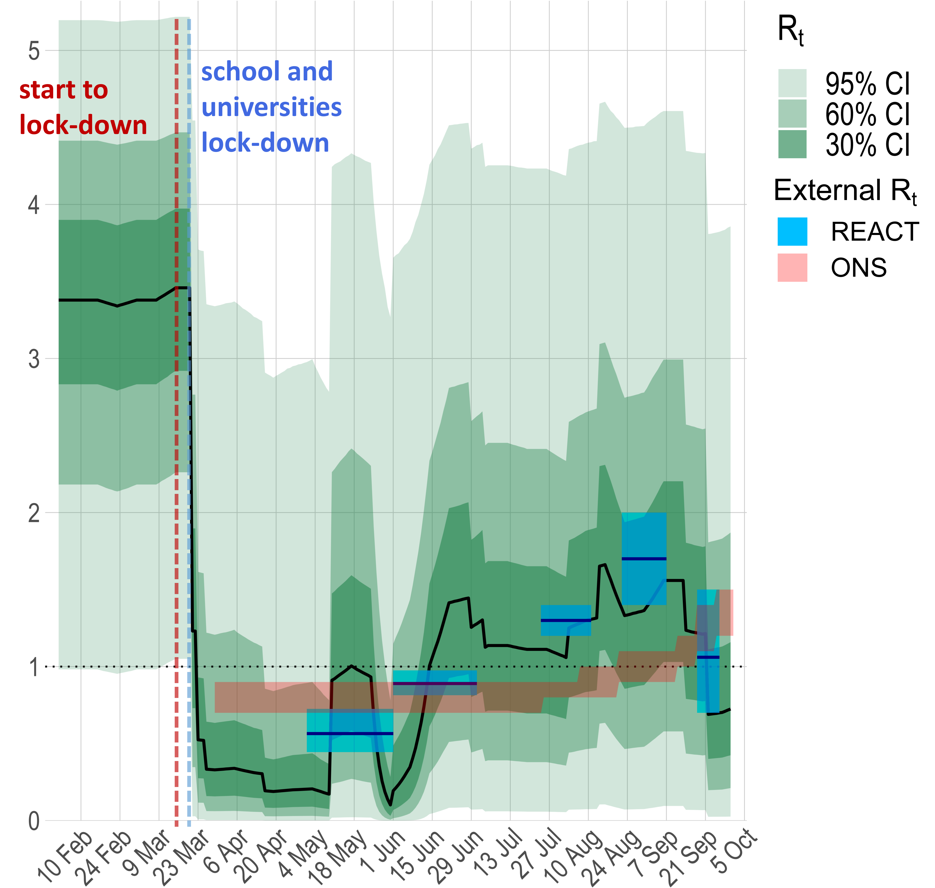
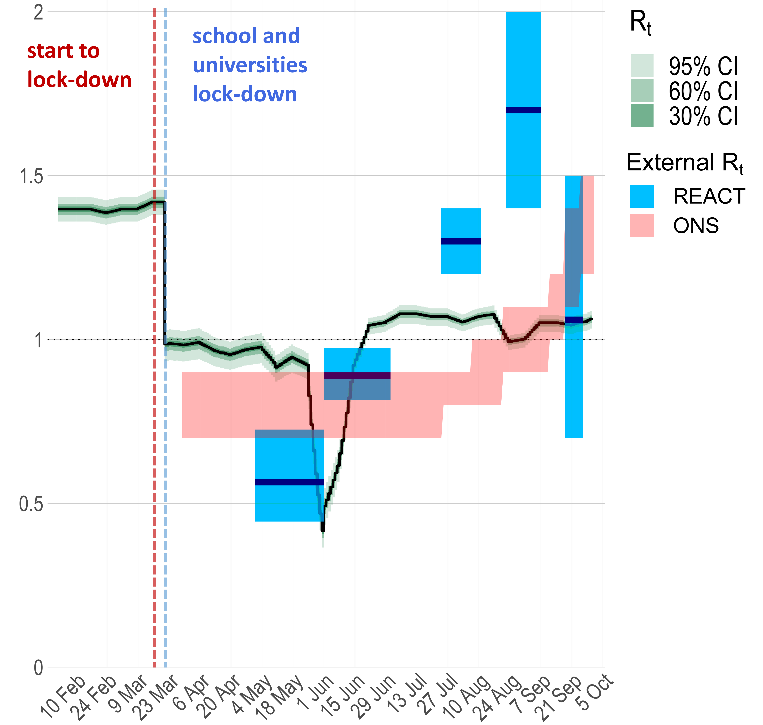
Inferring R_{t} through People in Mechanical Ventilation Beds
Figure 6: The prior and the posterior R_{t} inferred by the model
Notes:
Assuming that the lock-down of city and schools would significantly reduce the rt, while the protest of the citizens would eliminate the efforts of lock-down. Hence, the shape of the prior Rt has been determined by the variation of these two conditions.
To determine the location of prior reproduction, the maximum reproduction number should be figured out, then based on the Office for National Statistics and the experiment result on Real-time Assessment of Community Transmission team, REACT team for short from the Imperial College London. The Posterior rt could be inferred after the fitness of model. The green areas indicates confidence intervals. The blue and red areas show REACT result and ONS result respectively. It can be observed that Rt reaches its minimum of 0.42 with the 95% CI on May 31st. On June 17th, the 95% CI contains 10.98. Afterwards, the 95% CI is always greater than 1 or contains 1

Slide 17
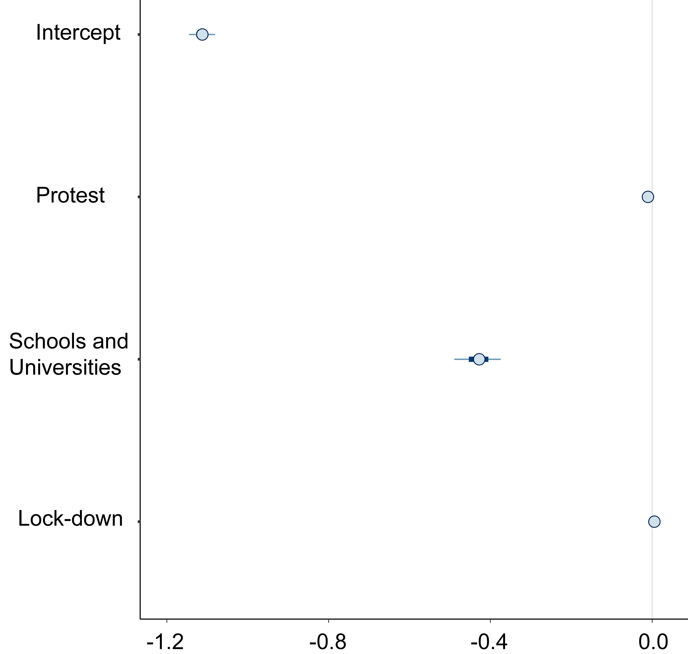
Inferring effect size
Main reason:
Lock-down of the Schools and Universities
Lock-down of Cities
Collinearity
The effect size of protest is not significant
Figure 7: Effect size of NPIs for reducing R_{t}
Notes:
The main reason of reducing R_{t} tend to be the lock-down of the schools and universities. It can be seen that the main reason is the lockdown of schools and universities. However, the collinearity between schools and cities is very high, so it can be seen that the effect size of the city lockdown has been disturbed by that of school lockdown. On the other hand, the effect size of protest is not significant, which means that when people search on the Internet, R_{t} will not significantly increase.

Slide 18
Inferring cumlative cases
The black line:
Median of cumulative cases.
The blue areas:
Confidence intervals of it.
External Data:
Lies within the 95%CI of inference
REACT group (red, England)
ONS (yellow, UK)
Oxford University (purple, Oxford)
Lies outside the 95% CI of inference
Oxford University
(purple, Great Glasgow Region)
Figure 8: Cumulative cases inferred from ventilated beds data
Notes:
To assess the accuracy of the inferred data, it is easy for cumulative cases to compare with the external data source. Because the antibody prevalence is able to stand for the cumulative cases in the early stage of Covid-19.
Hence, inferring from ventilated beds data and assuming this data is less than theoretical number, the Cumulative cases has been in presented in figure 8.
It could be seen that in Great Glasgow region, the cumulative infection result lies outside the confident interval.
It should be mentioned that external data has geographical bias, because sampling from the whole UK for the antibody tends to be impossible

Slide 19
Inferring the Daily Sampling effect on Covid-19
The estimation rises over time and reached 23.77% (8.81%,66.64%) on 1st 2020.
Although the effectiveness of testing is constantly improving, the sampling effect is still relatively low
The British government still has to work hard to enhance the sampling effort
Figure 9: Daily sampling effect inferred from increasing people in ventilation beds
Notes:
Then, the daily sampling effect could be simply calculated as daily increasing cases has been inferred.
The estimation rises over time and reached 23.77% on the last day of observation. This indicates that although the effectiveness of testing is constantly improving, the percentage of detected cases is still relatively low.
The British government still has to work hard to enhance the sampling effort.

Slide 20
Inferring cumlative cases
Figure 10: Daily Cumulative cases and sampling effects inferred from fatality data
Notes:
As what has been mentioned before, this thesis use three method to infer the daily cases. And the estimation from ventilated beds is the best one. The first reason is that the compliance of inferred data and external data is worse than the last method.
The second reason is that at the early stage of covid-19, the daily sampling effect cannot greater than 100%, while the result inferred from fatality data greater than 100%$. Hence, I chose the the result inferred from ventilated beds as the conclusion of my thesis.

Slide 21
Conclusion
Notes:
Last part is the Conclusion.

Slide 22
Conclusion
Sampling effect
31st January
1st October
The peak of inferred daily increasing cases is nearly 70K (46k, 107k) on March 20th in UK
1
The UK government did well after the first outbreak around 28th March, where the sampling effect keeps high after then, with some ups and downs
2
The NPIs taken by the UK governments could significantly reduce the R_{t} of SARS-CoV-2, while the protest for it has no significant impact on the R_{t}
3
Notes:
There are three conclusion for my thesis
First of all, The peak of inferred daily increasing cases is nearly 70K on March 20th in UK
Secondly, The UK government did well after the first outbreak around 28th March, where the sampling effect keeps high after then, with some ups and downs
Last but not the least, The NPIs taken by the UK governments could significantly reduce the R_{t} of SARS-CoV-2, while the protest for it has no significant impact on the R_{t}

Slide 23
Reference list
Inglesby, Thomas V. "Public Health Measures and the Reproduction Number of SARS-CoV-2." JAMA : The Journal of the American Medical Association 323.21 (2020): 2186-187. Web.
Seth Flaxman, Swapnil Mishra,Axel Gandy, H Juliette T Unwin, Thomas A Mellan,Helen Coupland, Charles Whittaker,Harrison Zhu,Tresnia Berah,Jeffrey W Eaton,et al. Estimating the effects of non-pharmaceutical interventions on covid- 19 in europe. Nature, 584(7820):257-261,2020.
Yao, Hangping, Yutong Song, Yong Chen, Nanping Wu, Jialu Xu, Chujie Sun, Jiaxing Zhang, Tianhao Weng, Zheyuan Zhang, Zhigang Wu, Linfang Cheng, Danrong Shi, Xiangyun Lu, Jianlin Lei, Max Crispin, Yigong Shi, Lanjuan Li, and Sai Li. "Molecular Architecture of the SARS-CoV-2 Virus." Cell 183.3 (2020): 730-38.e13. Web.
Notes:
This is my reference list

Slide 24
Thanks for your attention
Presenter: LBDB3
Date：24th September 2021
Notes:
Thanks for your attention

